Slide 1
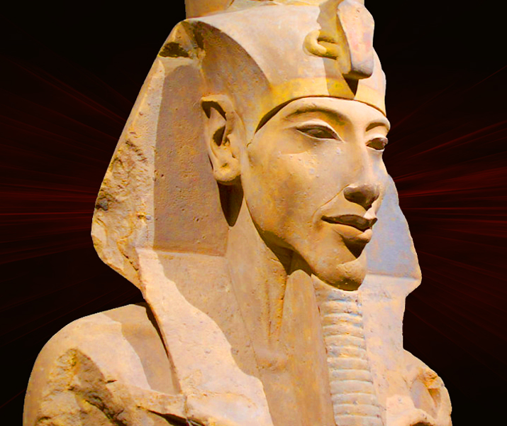
A New Name
GOAL/S: Identify the reasons for the name change
Analyse evidence sources
Week 1, Lesson 3

Slide 2
Importance of names
Names were believed to hold power and essence.
They reflected an individual’s role, identity, and relationship with the divine.
Example: name "Amenhotep IV" and its meaning –
"Amun is Satisfied"

Slide 3
Reasons for name change
Personal Religious Beliefs: Amenhotep IV’s devotion to the sun god Aten.
Political and Ideological Shift: Promotion of monotheism and rejection of traditional polytheistic beliefs.
Symbolic Representation: Akhenaten ("Effective for Aten") reflects his new religious focus.

Slide 4

ACTIVITY - Discussion
Discuss the following questions in pairs/groups
Write your answers on a STICKY NOTE
What is the importance of names in culture and society?
What are the implications/effects of his name change?

Slide 5
ACTIVITY – Impacts
SUMMARISE
Religious Impact:
Promotion of Atenism: Akhenaten's name change symbolised his dedication to the worship of the sun disk Aten as the supreme deity.
This shift marked a departure from the traditional polytheistic Egyptian religion centered around Amun and other gods.
Atenism emphasised monotheism and the belief in a single, universal god.

Slide 6
ACTIVITY – Impacts
SUMMARISE
Cultural and Political Impact:
Centralization of Power: The name change reflected Akhenaten's attempt to centralise religious and political authority. By emphasizing his role as the sole intermediary between Aten and the people, Akhenaten consolidated power within himself and his immediate family.
Changes in Art and Iconography: The shift in religious focus influenced Egyptian art and iconography. Art during Akhenaten's reign depicted naturalistic scenes and emphasised the rays of the sun disk, reflecting the new religious ideology.

Slide 7
ACTIVITY – Impacts
SUMMARISE
Legacy and Historical Impact:
Amarna Period: The name change is closely associated with the Amarna Period, characterised by significant changes in art, religion, and royal practice. This period represents a distinct phase in Egyptian history marked by Akhenaten's religious reforms and the establishment of Akhetaten (Amarna) as the new capital.
Aftermath and Reversal: After Akhenaten's death, his reforms were largely reversed, and Egypt returned to its traditional religious practices. However, the Amarna Period left a lasting impact on Egyptian art and religious thought, influencing subsequent pharaohs and religious developments.

Slide 8
ACTIVITY – Impacts
SUMMARISE
Historiographical Impact:
Scholarly Interest: The name change and Akhenaten's reign have attracted considerable scholarly interest due to their unique religious and cultural implications. Historians and archaeologists study Akhenaten's reign to understand the dynamics of religious change, royal authority, and artistic expression in ancient Egypt.

Slide 9
Watch the following:
Documentary: https://www.youtube.com/watch?v=qnIK5RryfZ4&ab_channel=Biographics

